Slide 1
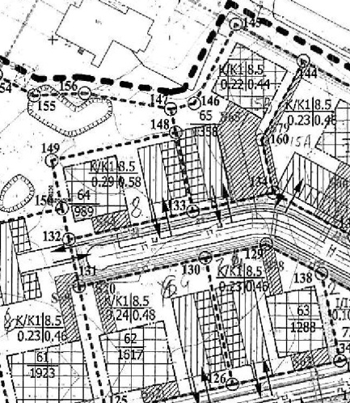
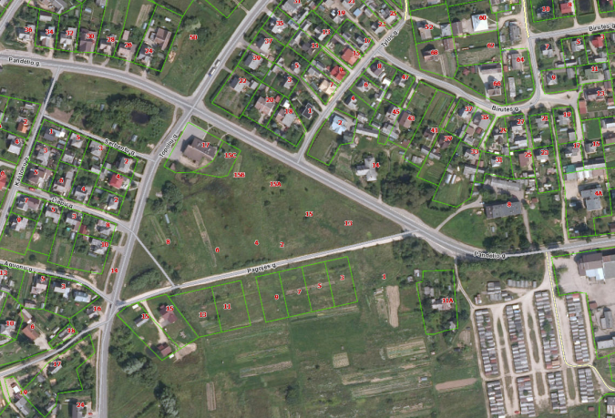

Commercial Land
Rokiskis District Municipality Administration
Plan of the land Photo of the land
Address | Rokiskis town, Pandėlio str.15B
Lot size | 0,1358 Ha
Electricity | 200m distance to substation of power system
Water | 150 m, d200 mm distance to water network
Telecommunications | 10 m distance to internet, telephone network
Distance to the main road | 0,02Km
Price/other conditions | Has not offerred for sale at an auction Detailed plan has prepared Land is commercial

